Slide 1

SC1015
Suicide Risk Assesment
Wong Zi Jun U2221712A
Vithun Natesh Balakathiravan U2221650C

Slide 2
Table of contents
01
02
03
04
Introduction
Data wrangling
Aim of the project
Data cleaning, preprocessing, EDA
Methodology
Experiments & Conclusion
Models - Decision Tree,
Random Forest, XGBoost
Analysis and Evaluation

Slide 3
01
Introduction
Objective
Exploring the key indicators of suicide.
Understanding the factors that can help identify individuals at higher risk.
Significance of this project (Applications)
Identify and better allocate resources to those at risk
Influence government policies on suicide prevention
Better awareness of those at risk

Slide 4

01
DATASETS
DATASET #1
DATASET #2
Suicide rates overview 1985 - 2021
Country mapping, ISO, Continent, Region
https://www.kaggle.com/datasets/omkargowda/suicide-rates-overview-1985-to-2021
https://www.kaggle.com/datasets/andradaolteanu/country-mapping-iso-continent-region

Slide 5
02
Data Cleaning
Drop unnecessary columns in regionalData dataframe
Renaming column names in dataframes

Slide 6
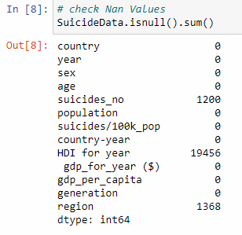
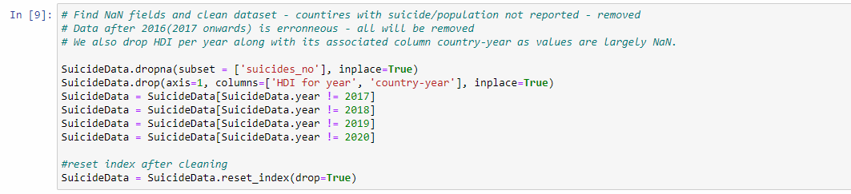
02
Data Cleaning
Drop all countries with NaN suicides reported
Drop HDI per year along with its associated column country-yea - values are largely NaN thus largely unusable
Remove years after 2016 as data is erroneous - population figures are inaccurate

Slide 7
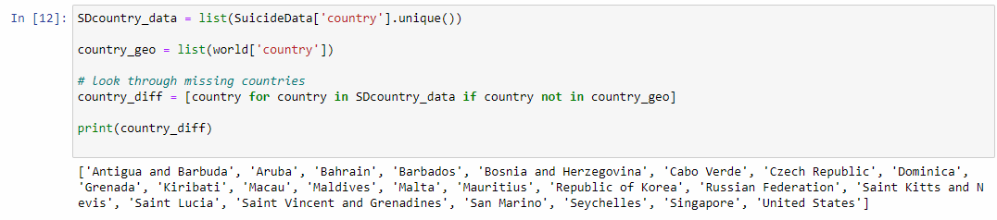
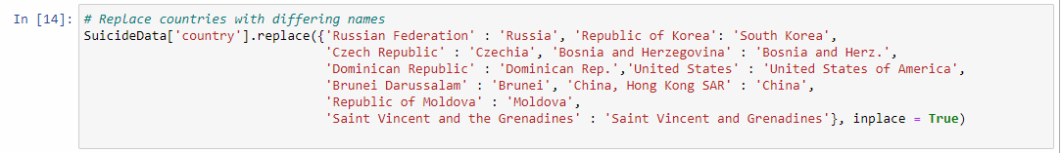
02
Data Cleaning
We learnt geopandas, and used their built in shapefile to initialise a world map
Checking if same country exists in both datasets and if under the same or different name
Some countries have different names on geopandas shapefile, match country names for eventual merging of datasets

Slide 8
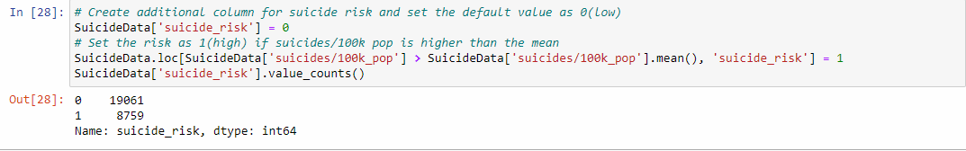
02
Data Preprocessing
Create a new binary categorical variable, suicide_risk
Allow us to categorize those who need help and those who do not
High risk is defined by have higher than mean suicide rates.
High-> 1 Low-> 0

Slide 9
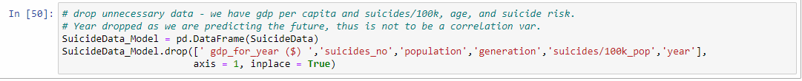
02
Data Preprocessing
Remove unnecessary columns to reduce noise.
Gdp for year is normalised to gdp per capita
Suicide risk is determined by suicides/100k, which is normalised from suicide numbers, population
generation is derived from age
Remove year variable

Slide 10
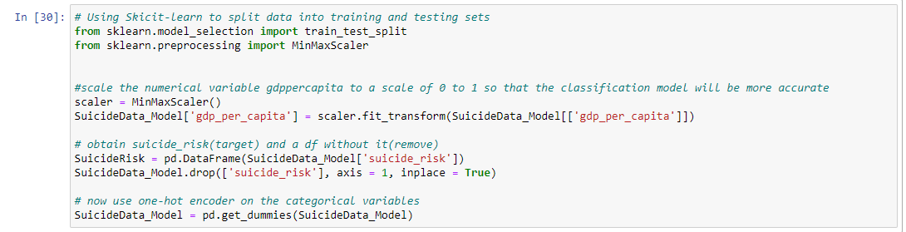
02
Data Preprocessing
We learnt and applied one-hot encoding on the categorical variables using MinMaxScaler - transform categories into numerical form to easily input into models and improve prediction accuracy
Then, create 2 dataframes - one with target variable, and other with predictors

Slide 11
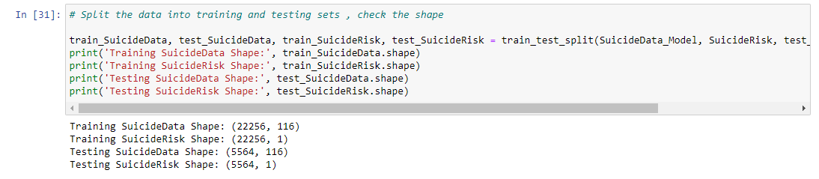
02
Data Preprocessing
We split the data 8:2, train and test data using train_test_split.
prevents model from overfitting if we were to train and test on the same data set.
Validate our model with different data

Slide 12
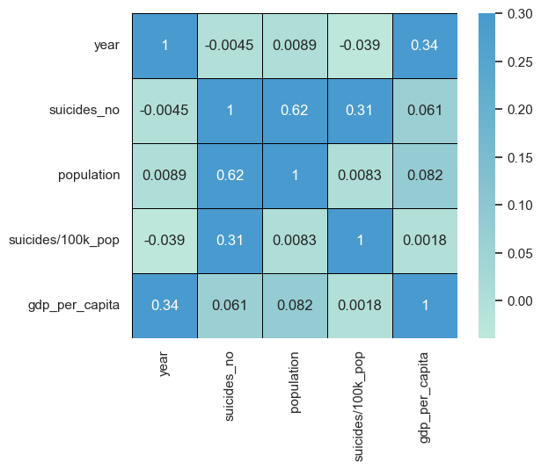
02
Exploratory Data Analysis
Numeric correlation values against Suicide/100k
No clear correlation present
Population has the highest correlation
population not good indicators once normalised
GDP per capita has weakest correlation

Slide 13
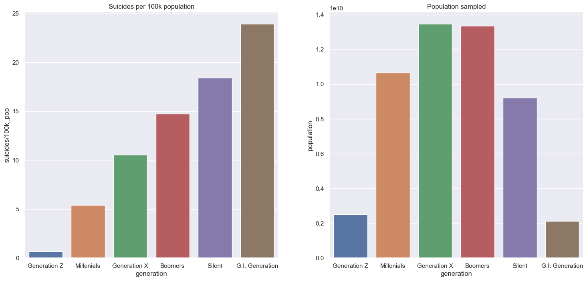
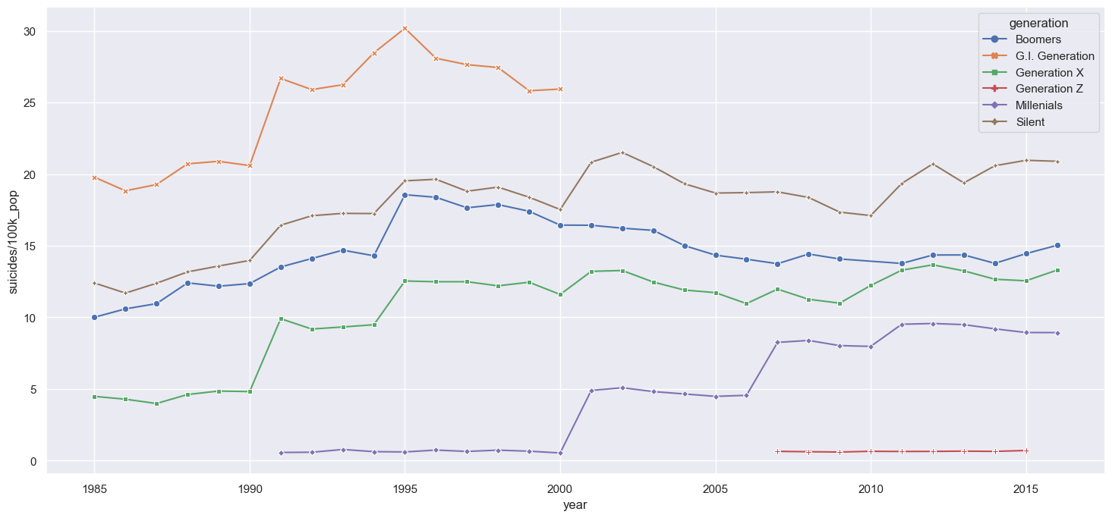
02
Exploratory Data Analysis
From the data, it can be seen that as age increases, suicide/100K increases
Suicide rate seem to be correlated to Age
Legend:
5-14 Years - Generation Z
15-24 Years - Millennials
25-34 Years - Generation X
35-54 Years - Boomers
55-74 Years - Silent
75++ Years - G.I. Generation

Slide 14
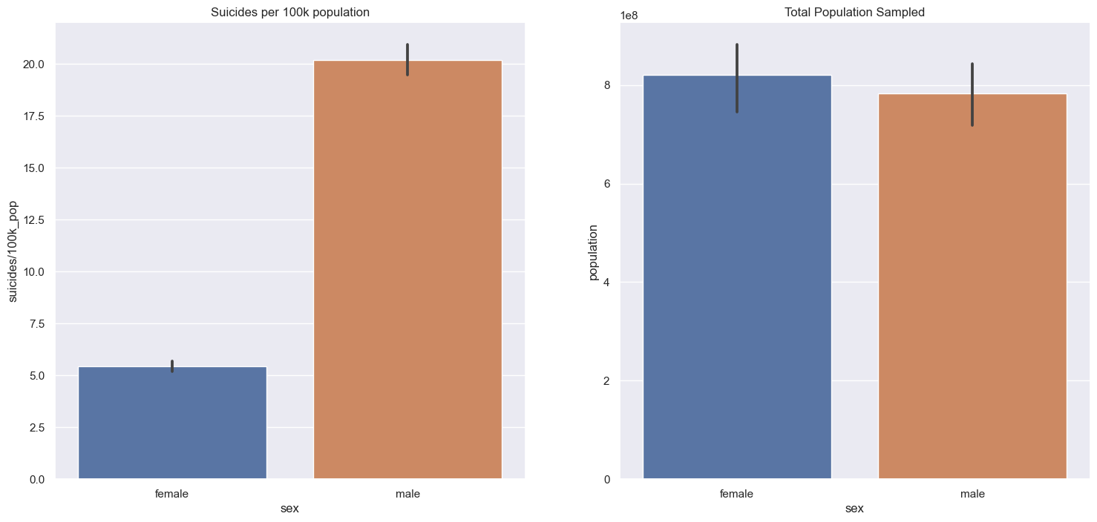
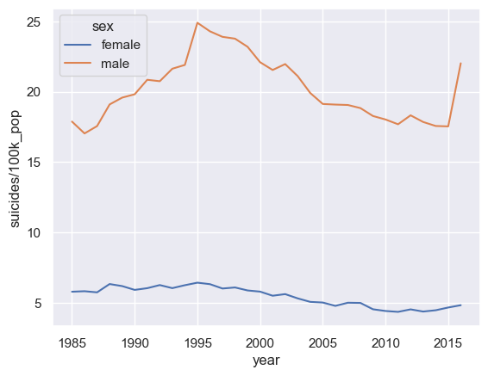
02
Exploratory Data Analysis
Males are ~4x more likely to commit suicide.
Possibly due to social construct.
This trend is consistent over the years.

Slide 15
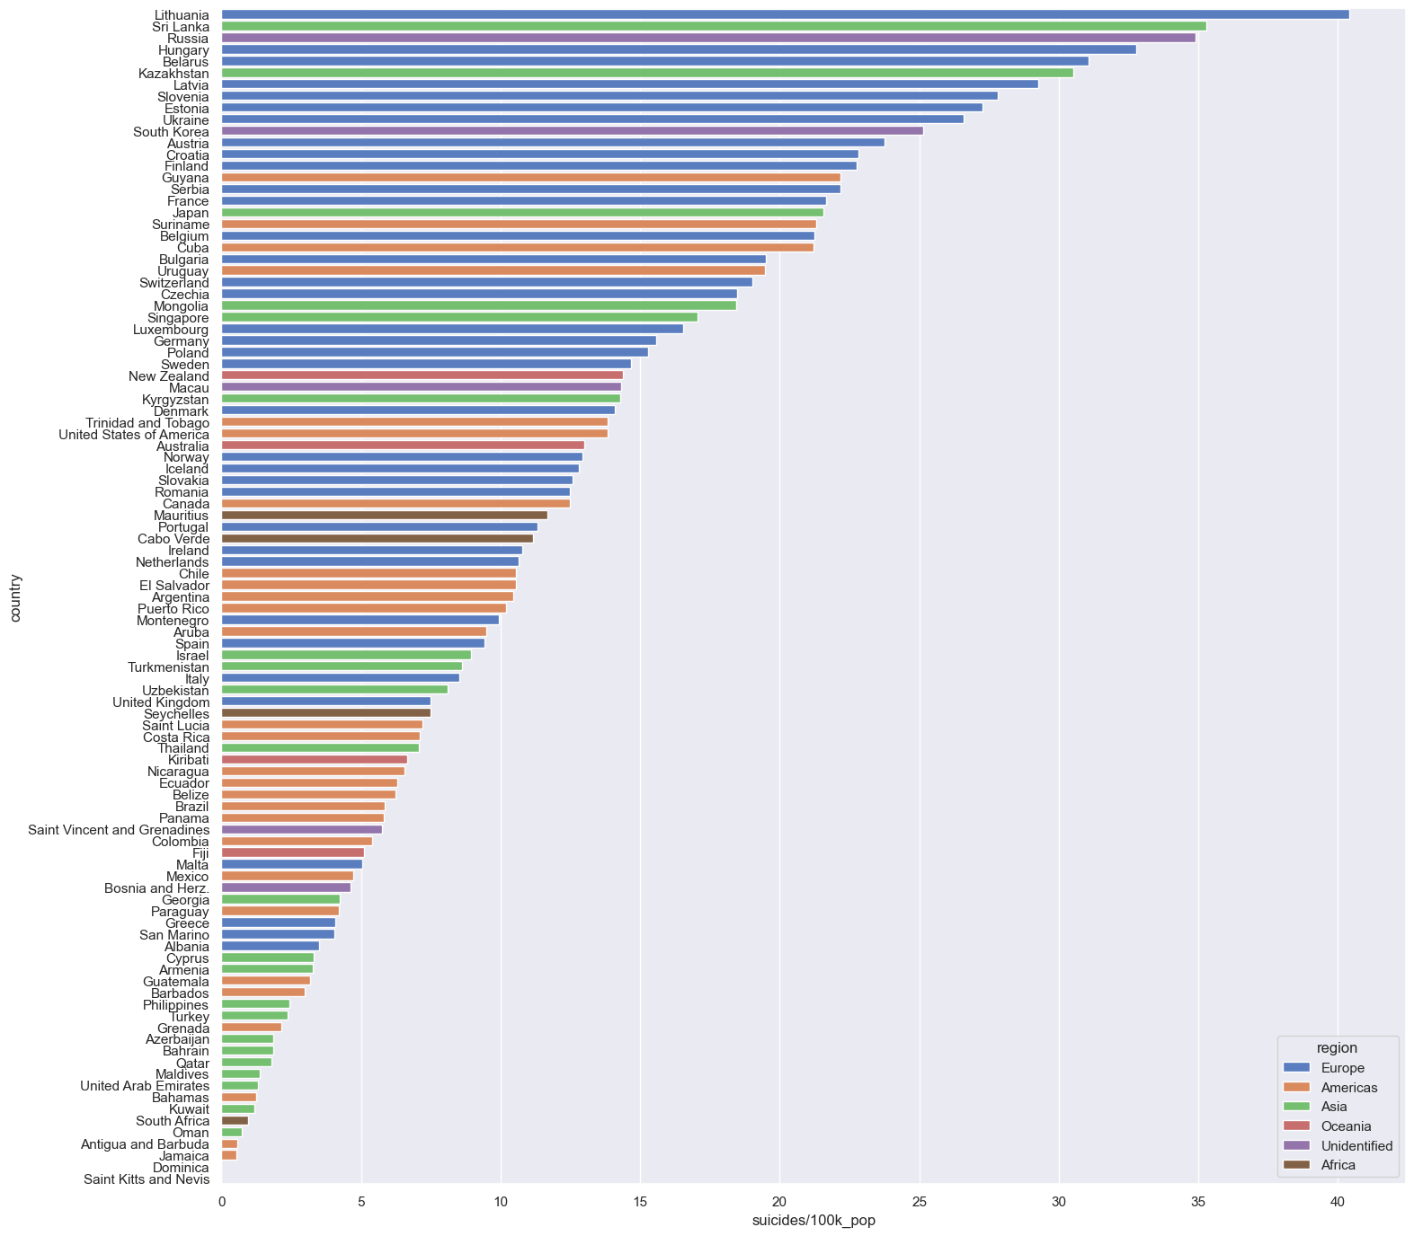
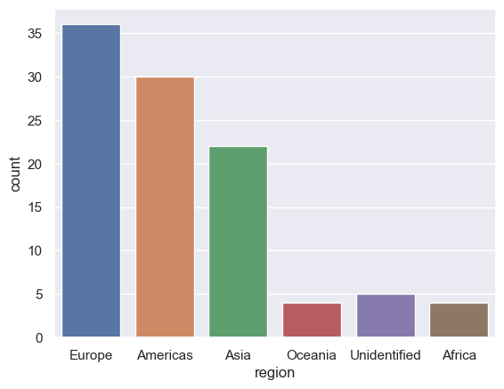
02
Exploratory Data Analysis
Europe, Asia and America have similar number of countries in data.
Europe seems to have highest suicide rates

Slide 16
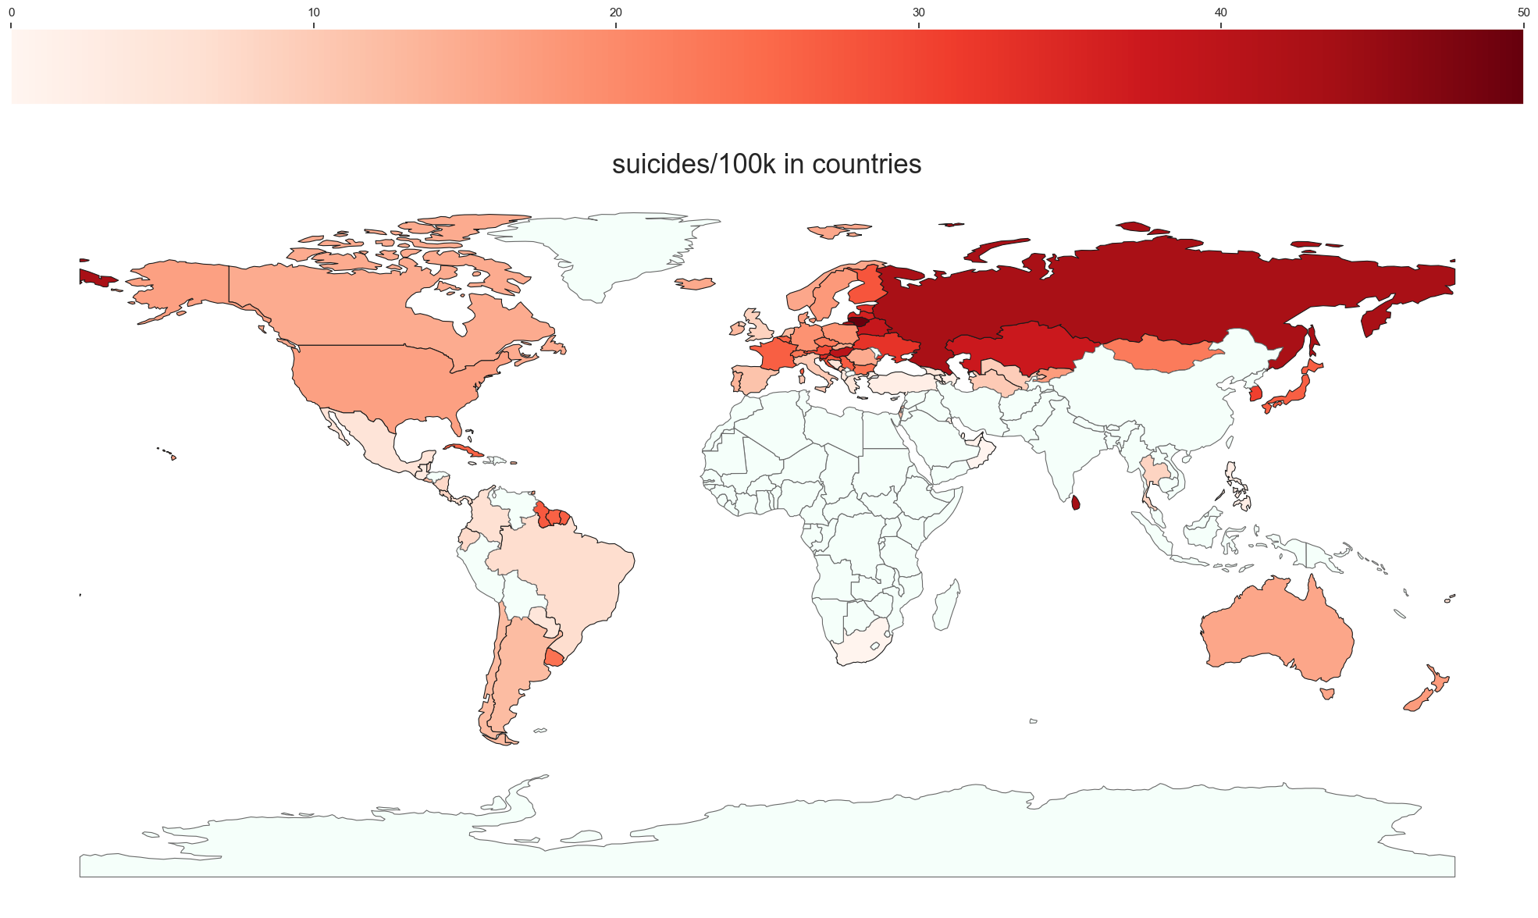
02
Exploratory Data Analysis
Using Geopandas
A better visualisation tool:
A choropleth map
Considerations
Lack of data in Africa, Asia.
Future models are not representative of these continents

Slide 17
03
Machine Learning
Models used: Decision Tree, Random Forest, XGBOOST
Baseline: Decision Tree
Input for all models
same set of training data and testing data obtained from train_test_split for backtesting
Performance metrics
classification accuracy
true positive rate
false positive rate

Slide 18
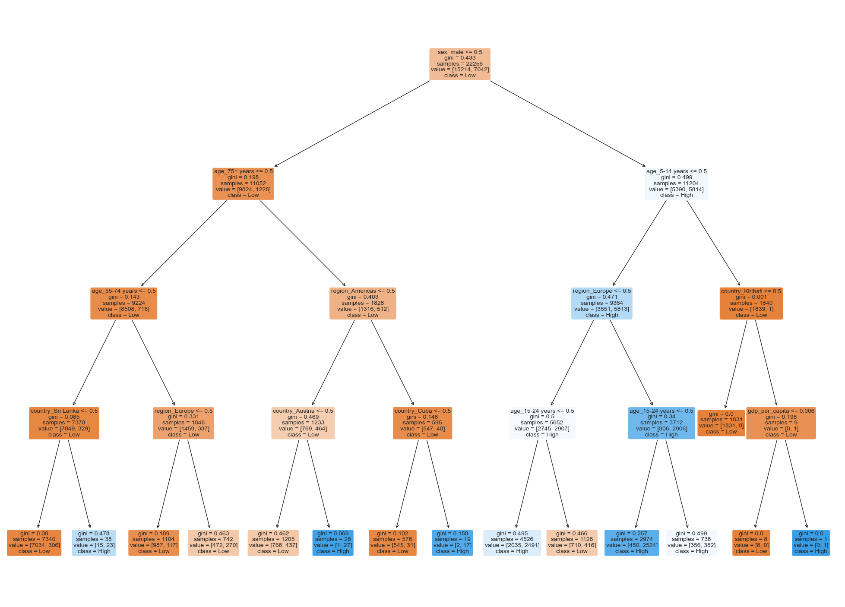
03
Decision Tree
Supervised learning algorithm. Utilized here for classification of binary categorical variable.
Hyperparameter: Depth
Depth of 4 is used to avoid overfitting but still have good/acceptable classification accuracy

Slide 19
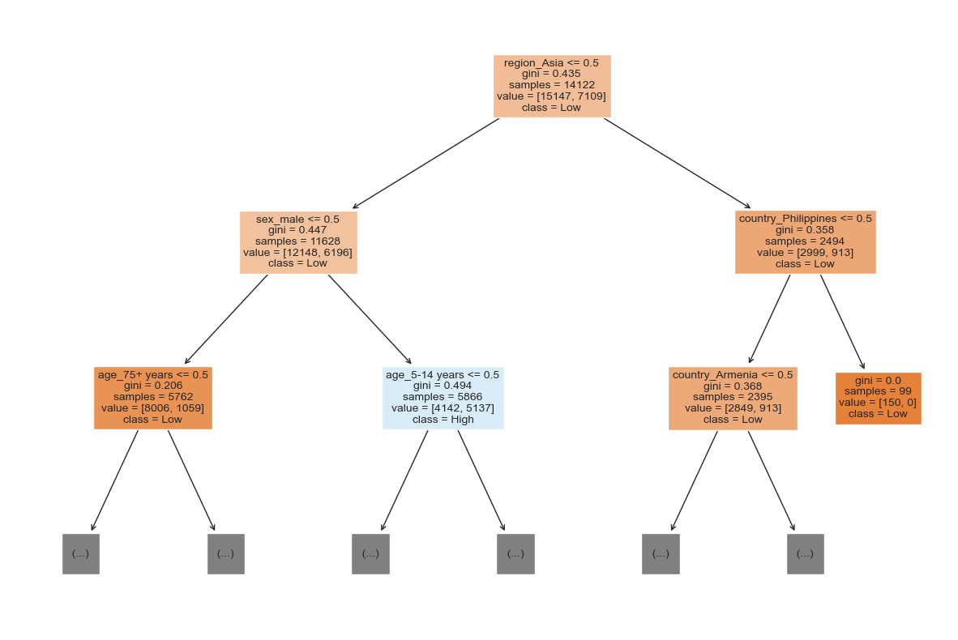
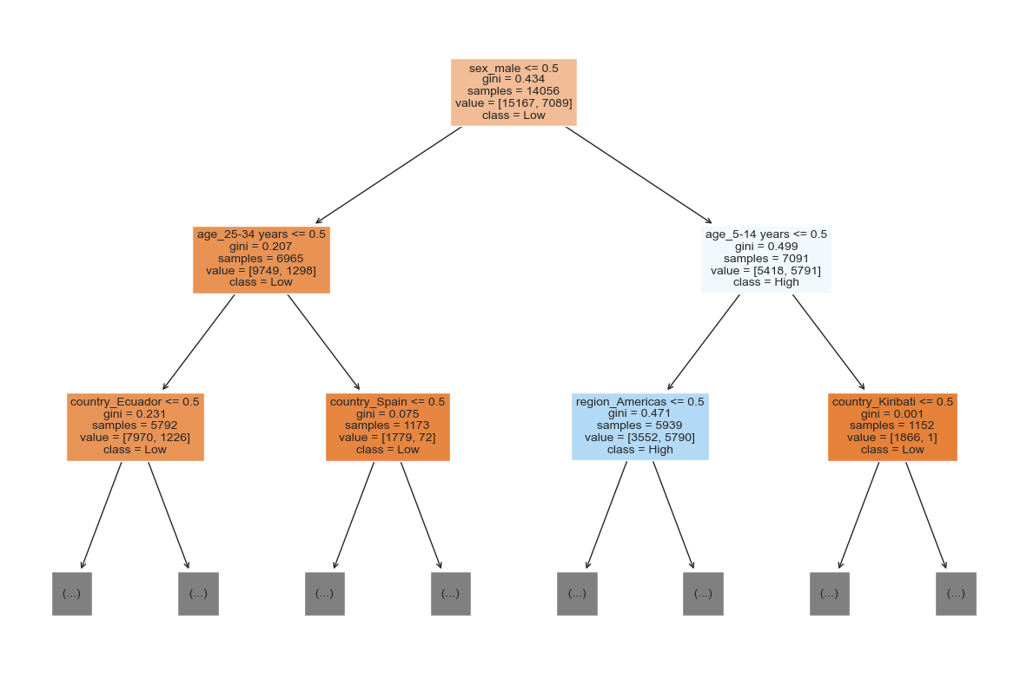
03
Random Forest
Ensemble learning algorithm - combines the output of multiple decision trees to reach a single result.
Hyperparameters: Trees, Bootstrap
Bootstrap - True. Ensure overfitting does not occur through statistical resampling
Trees - 100. Sufficient trees to achieve good accuracy, while not too computationally intensive
Decision Tree 1
Decision Tree 6

Slide 20
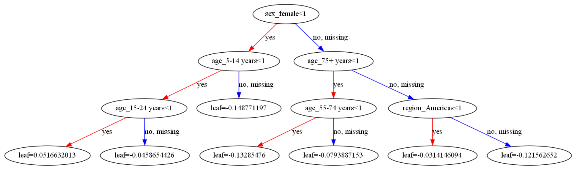
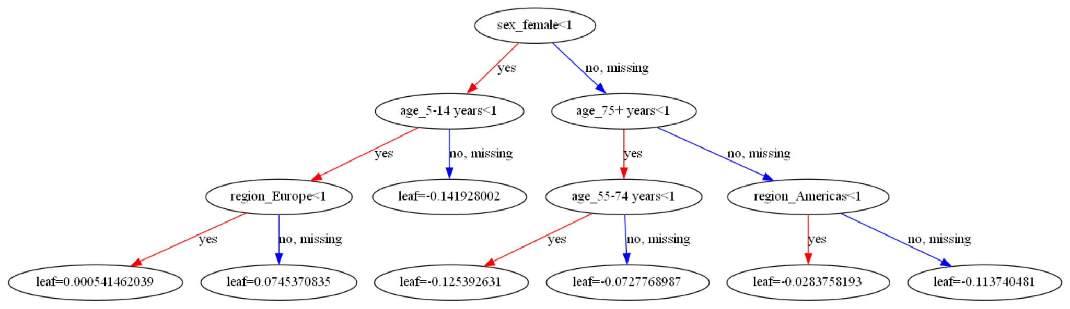
03
XGBoost
XGBOOST - A scalable, and highly accurate form of gradient-boosting algorithm. Each subsequent tree learns from the previous trees and is not assigned equal weight - (giving more weight to features that perform better), unlike how random forest works.
Hyperparameters: objective, eta, max_depth
Objective - binary:logistic. For binary classification using logistic regression.
Max depth - 3. To prevent overfitting
eta(learning rate) - 0.3. Fit model slower to prevent overfitting
Gradient boosting decision trees (graphviz)

Slide 21
04
Evaluation of models
Using model trained by training data, we test model on seperate test data. .score() function was used to obtain classification accuracy. True positive and False positive rates were calculated using custom function print_confusion_matrix()
DecTree
Classification Accuracy : 0.802
True positive : 0.758
False positive : 0.178
RandomForest
Classification Accuracy : 0.934
True positive : 0.949
False positive : 0.090
XGBoost
Classification Accuracy : 0.906
True positive : 0.851
False positive : 0.068
Highest Classification Accuracy : Random Forest
Highest True positive : Random Forest
Lowest False Positive : XGBoost

Slide 22
04
Evaluation of models
Random Forest
Highest Classification Accuracy : Random Forest
Highest True positive : Random Forest
Lowest False Positive : XGBoost
Classification Accuracy - overall model accuracy in predicting suicide risk
True positive - Those of suicide risk correctly identified - make sure all those who needs help get help, all lives matter
False Positive - Those not of suicide risk categorized to be of suicide risk - results in wasted resources

Slide 23
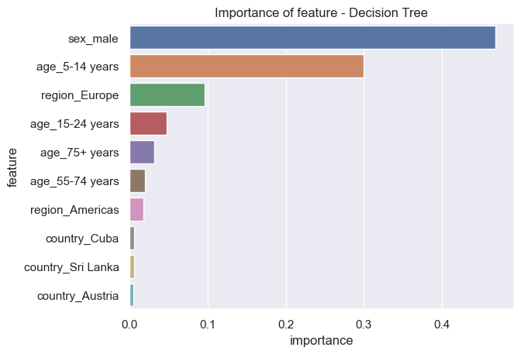
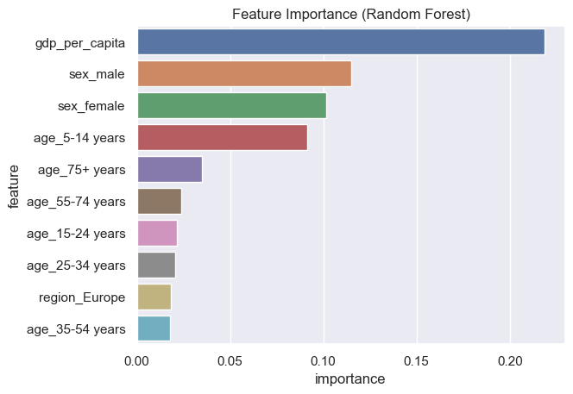
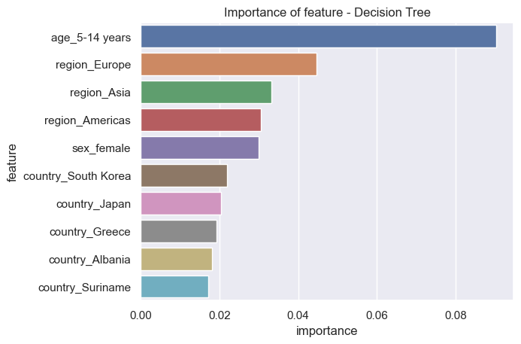
04
Data Driven Insights
We obtain importance of features using model.feature_importances_
Decision Tree
Random Forest
XGBoost
Sex, 5-14 years, Europe
Gdp_per_capita, Sex, 5-14 years
5-14 years, Europe, Asia
Notes:
GDP per capita, followed by sex and age, then europe as a region are the most important factors for RF model. These are the factors that we have to use, in order to reduce suicide rate by helping those with higher likelihood of suicide risk.

Slide 24
05
Conclusion
Areas to possibly improve on:
Use of hyperparameter tuning algorithms to determine optimal hyperparameters
Repeat multiple times and take average on different train-test split data to reduce variance as dataset is decent but not very large
Imbalanced Data. Low ~2x High in suicide_risk. Possible solution of oversampling or undersampling to balance data.
Instead of using mean suicide rate as a benchmark, should possibly use 90th percentile benchmark as a better representation of those more likely of suicide.
Limitations of Random Forest
large number of trees can make the algorithm too slow and ineffective for real-time predictions
XGBoost is a possible alternative

Slide 25
Thank You

